Slide 1
SPRING VALLEY VILLAGE POLICE DEPARTMENT
MONTHLY NEWSLETTER:
MAY 2025
1025 CAMPBELL ROAD
HOUSTON, TX 77055
PHONE: 713-465-8323
COMMUNITY MATTERS.
WE ARE A TEAM.

Slide 2
INTRODUCTION
Hilshire Village Residents,
May is here and soon school will be out. As warmer weather approaches, let’s not forget pool safety.
KEEP IN MIND:
Be sure to lock all doors and windows in your home, when you are not on the premises.
Bring all packages inside as soon as possible.
Lock your vehicle when it is unoccupied.
Be aware of increased activity regarding children playing outside.
As always we are here if you need us!
Sincerely,
Chief M. Schulze
1025 CAMPBELL ROAD, HOUSTON, TX 77055
PHONE: 713-465-8323 / EMAIL: DISPATCH@SPRINGVALLEYTX.COM

Slide 3
MAY 2025
DATE | DAY | SPECIAL DAYS FOR THIS MONTH
05-01-2025 | THURSDAY | NATIONAL DAY OF PRAYER
05-11-2025 | SUNDAY | MOTHER’S DAY
05-11-2025 | SUNDAY | POLICE OFFICER MEMORIAL WEEK BEGINS
05-26-2025 | MONDAY | MEMORIAL DAY
COMMUNITY MATTERS.
WE ARE A TEAM.
1025 CAMPBELL ROAD, HOUSTON, TX 77055 / PHONE: 713-465-8323 / EMAIL: DISPATCH@SPRINGVALLEYTX.COM

Slide 4
Police Officer Memorial Week May 11th – 17th
National Police Week was created in 1962; after then-president of the United States, John F. Kennedy signed Public Law 87-726. The law designated May 15 as Peace Officers’ Memorial Day and stated that the week in which the day falls should be National Police Week. Every year, the National Law Enforcement Officers organize a Memorial Service to honor police officers who lost their lives in the line of duty.
The goal of National Police Week is to honor and celebrate these officers.
Sincerely,
Chief M. Schulze
1025 CAMPBELL ROAD, HOUSTON, TX 77055
PHONE: 713-465-8323 / EMAIL: DISPATCH@SPRINGVALLEYTX.COM

Slide 5
Shout out to our Municipal Court. We work together because our Community matters. We are a team!
Celebrating the 56th Annual Professional Municipal Clerks Week
May 4th through May 10th will be the 56th Annual Professional Municipal Clerks Week. Initiated in 1969 by IIMC and endorsed by all of its members throughout the United States, Canada and 15 other countries, the week is a time of celebration and reflection on the importance of the Clerk’s office. In 1984, President Ronald Reagan signed a proclamation that officially declared Municipal Clerks Week the first full week of May.
COMMUNITY MATTERS.
WE ARE A TEAM.
Sincerely,
Chief M. Schulze
1025 CAMPBELL ROAD, HOUSTON, TX 77055
PHONE: 713-465-8323 / EMAIL: DISPATCH@SPRINGVALLEYTX.COM

Slide 6
SPRING VALLEY VILLAGE POLICE DEPARTMENT
OFFICER’S TIP OF THE MONTH
Summer break is just around the corner, which means people will start to travel.
It is important that people be careful, especially on vacation.
Here are some travel safety tips to help enjoy those vacation moments:
Contact the police department to be placed on the "Vacation House Watch"
Turn on some lights in the house.
Let your friends or neighbors know when you will be away and your emergency contact numbers.
Officer R. Moore
Avoid “Oversharing” Online: Posting photos or checking in on social media sites advertises your absence from home. Real-time updates can be tempting but wait until you return safely home before sharing your adventures.
Travel like a Local: Make sure to know surroundings by planning a route in advance.
Travel with a Buddy or in groups!
Officer D. McDaniel
COMMUNITY MATTERS.
WE ARE A TEAM.
1025 CAMPBELL ROAD, HOUSTON, TX 77055
PHONE: 713-465-8323 / EMAIL: DISPATCH@SPRINGVALLEYTX.COM

Slide 7
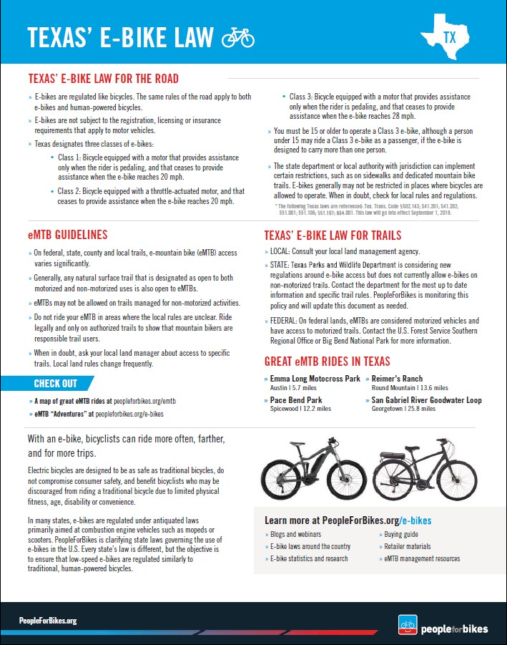
COMMUNITY MATTERS.
WE ARE A TEAM.

Slide 8
COMMUNITY MATTERS.
WE ARE A TEAM.
1025 CAMPBELL ROAD, HOUSTON, TX 77055
PHONE: 713-465-8323 / EMAIL: DISPATCH@SPRINGVALLEYTX.COM

Slide 9
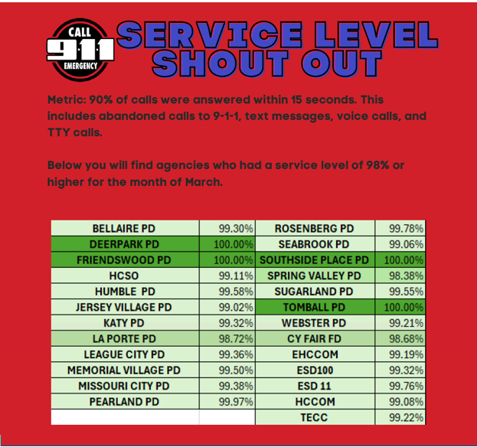
SPRING VALLEY VILLAGE POLICE DEPARTMENT
COMMUNITY MATTERS.
WE ARE A TEAM.
1025 CAMPBELL ROAD, HOUSTON, TX 77055
PHONE: 713-465-8323 / EMAIL: DISPATCH@SPRINGVALLEYTX.COM

Slide 10
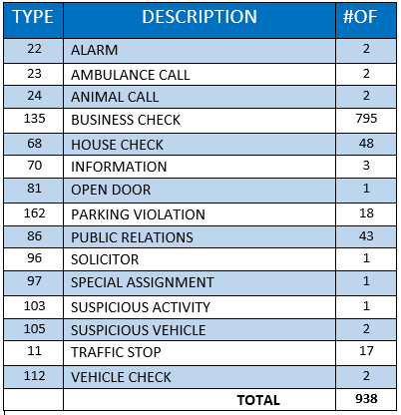
SPRING VALLEY POLICE DEPARTMENT
HILSHIRE VILLAGE
CALLS BY TYPE: 04-01-2025 THRU 04-30-2025
COMMUNITY MATTERS.
WE ARE A TEAM.
1025 CAMPBELL ROAD, HOUSTON, TX 77055
PHONE: 713-465-8323 / EMAIL: DISPATCH@SPRINGVALLEYTX.COM

Slide 11
IMPORTANT NUMBERS AT A GLANCE
EMERGENCY |  | NON - EMERGENCY
911 - FOR ALL EMERGENCY |  | 713-465-8323
988 – NATIONAL SUICIDE & MENTAL HEALTH
SPRING VALLEY VILLAGE |  | VILLAGE FIRE DEPARTMENT
SPRING VALLEY - CITY HALL | 713-465-8308 | VILLAGE FIRE DEPARTMENT |  | 713-465-2323
SPRING VALLEY - PD | 713-465-8323 | VFD - NON-EMERGENCY |  | 713-468-7941
SPRING VALLEY - PD FAX | 713-465-3135
SPRING VALLEY - COURT | 713-465-0333
HILSHIRE VILLAGE
HILSHIRE VILLAGE – CITY HALL | 713-973-1779
COMMUNITY MATTERS.
WE ARE A TEAM.
1025 CAMPBELL ROAD, HOUSTON, TX 77055 / PHONE: 713-465-8323 / EMAIL: DISPATCH@SPRINGVALLEYTX.COM

Slide 12
CITY HALL WILL BE CLOSED FOR MEMORIAL DAY HOLIDAY ON MAY 26, 2025.
COMMUNITY MATTERS.
WE ARE A TEAM.
1025 CAMPBELL ROAD, HOUSTON, TX 77055
PHONE: 713-465-8323 / EMAIL: DISPATCH@SPRINGVALLEYTX.COM

